Slide 1

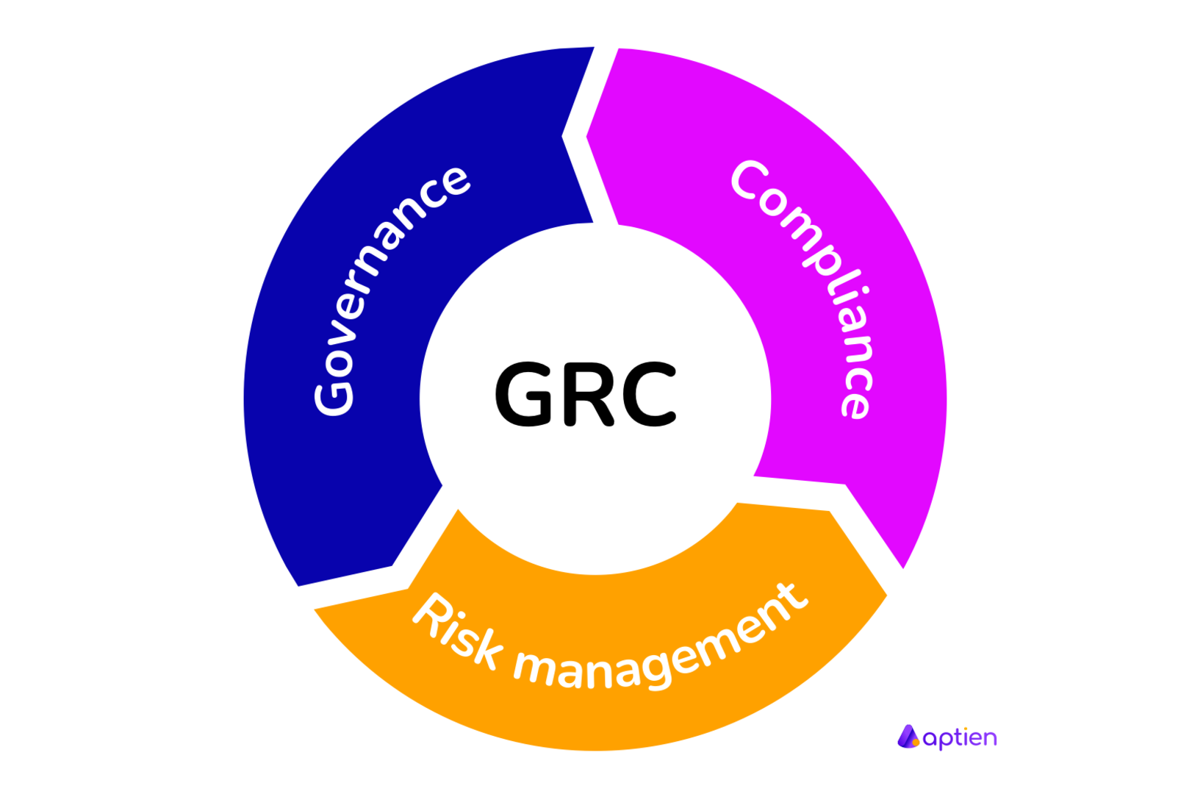


Governance Risk and Compliance

Slide 2
Introduction to GRC
Governance, Risk, and Compliance (GRC) is a framework that helps organizations manage and integrate their governance, risk management, and compliance activities.

Slide 3
RISK MANAGEMENT PROCESS
DAY 01

Slide 4
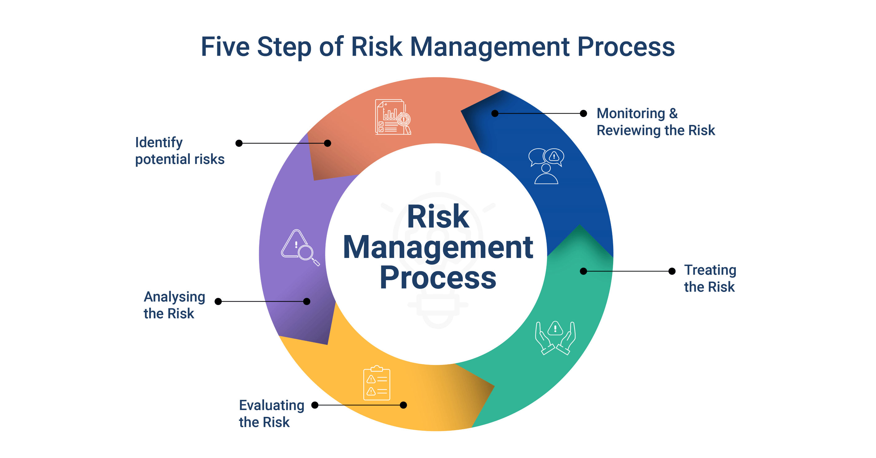
DAY 01

Slide 5
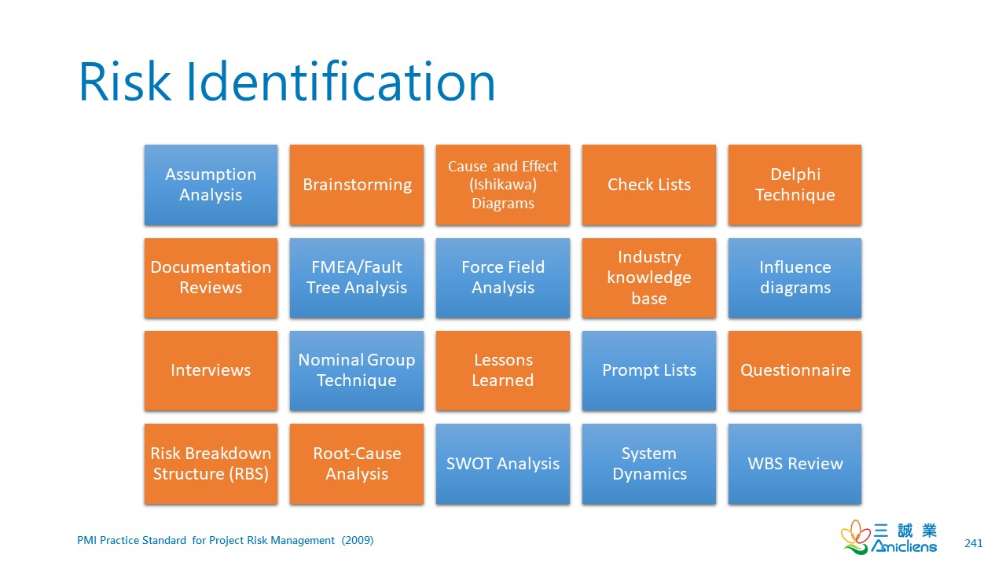
RISK IDENTIFICATION
DAY 01

Slide 6
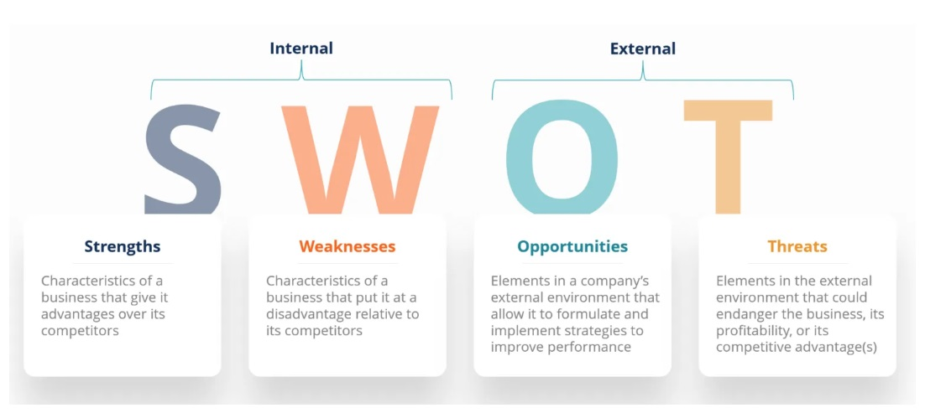
SWOT (RISK IDENTIFICATION TOOL)
DAY 01

Slide 7
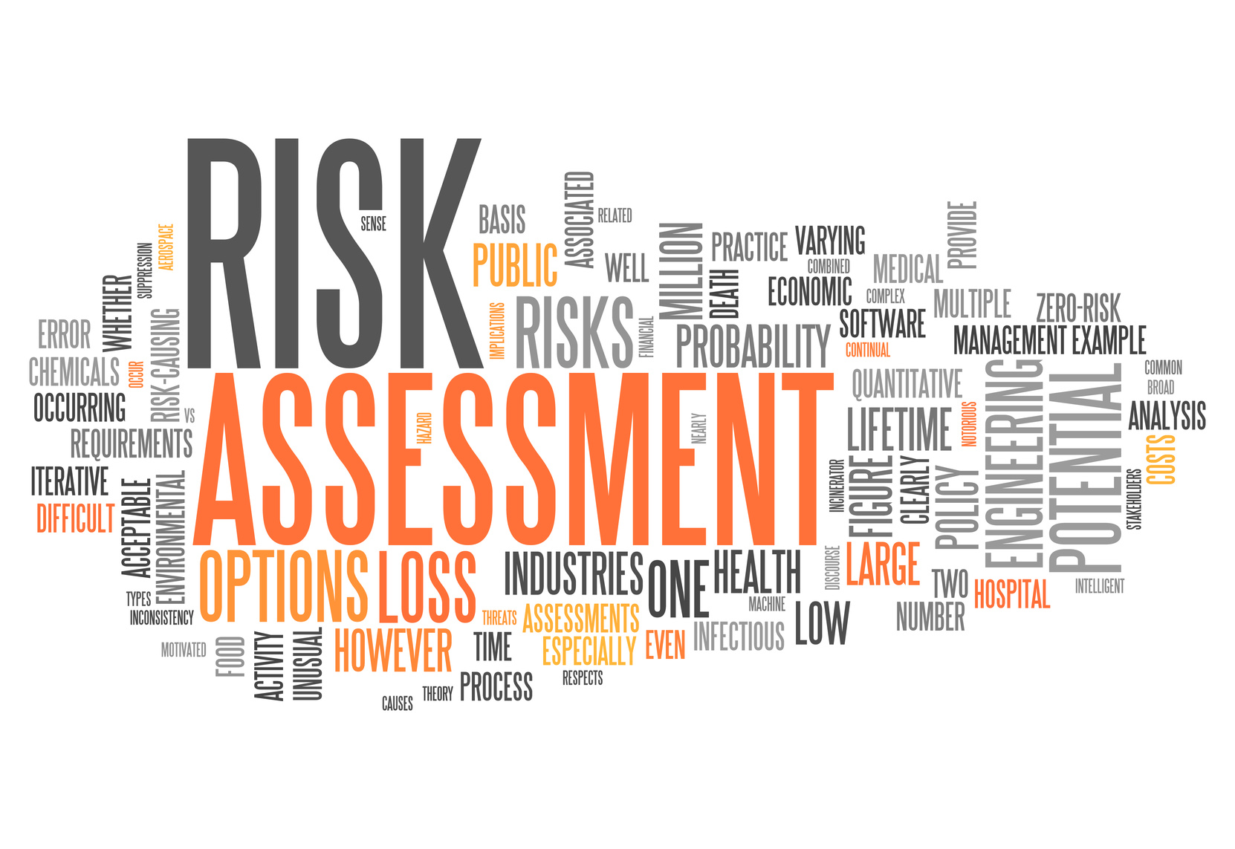
RISK ANALYSIS (ASSESSMENT)
DAY 01

Slide 8
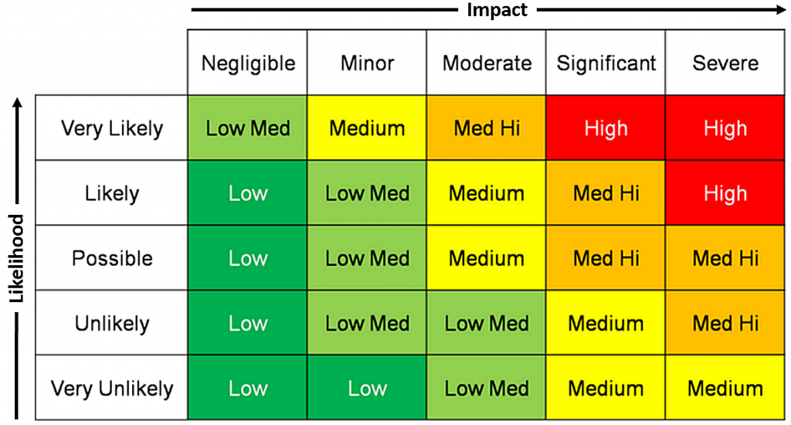
RISK ANALYSIS TOOL- RISK MATRIX
DAY 01

Slide 9
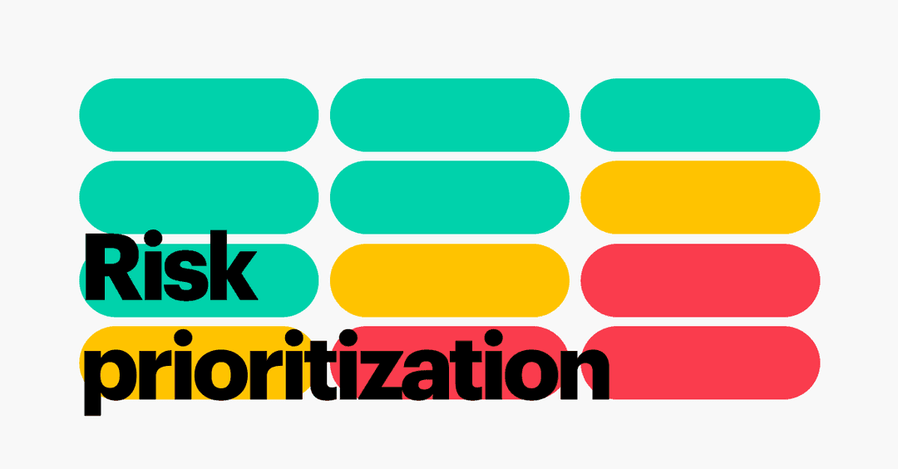
RISK PRIORTIZATION
DAY 01

Slide 10
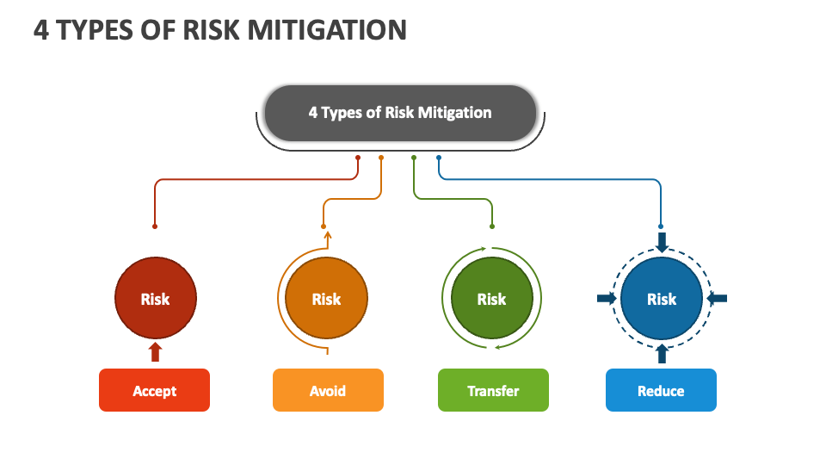
RISK MITIGATION
DAY 01

Slide 11
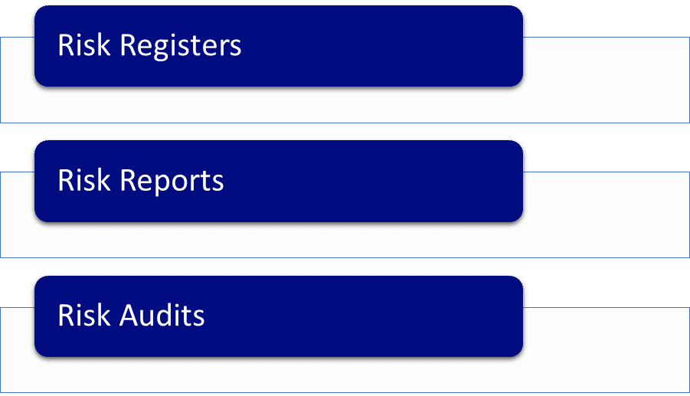
RISK MONITORING
DAY 01

Slide 12
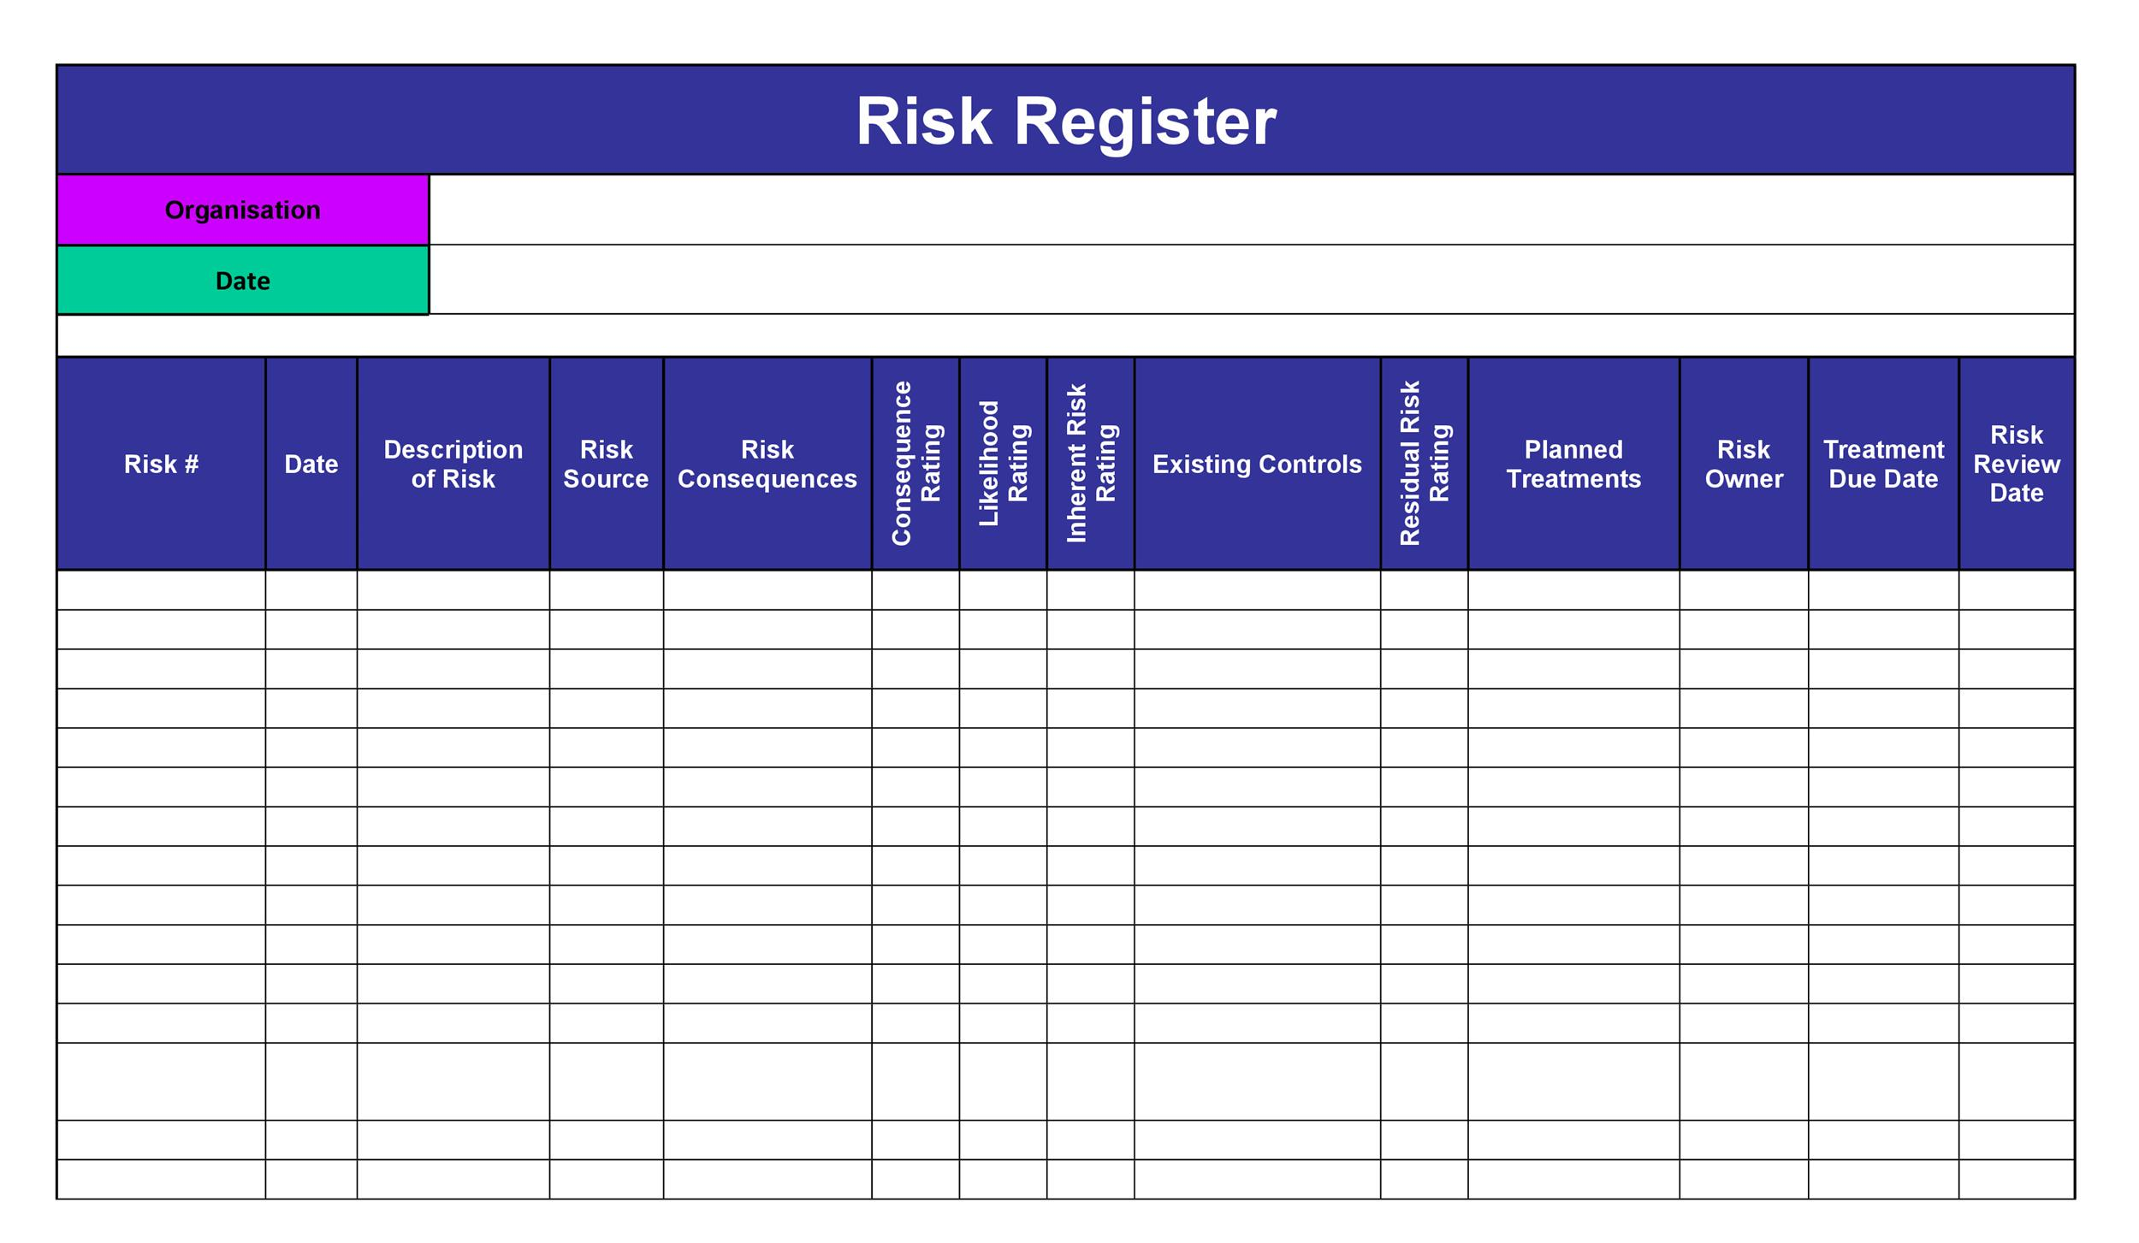
RISK REGISTER TOOL
DAY 01

Slide 13


Slide 14
What coming next?
INTEGRATED GRC
&
SERVICENOW TOOL INTRO

