Slide 1

What We Covered Yesterday
DAY 02
Introduction to GRC
&
Risk Management Process

Slide 2
Today’s AGENDA
DAY 02
INTEGRATED GRC
&
SERVICENOW TOOL INTRO

Slide 3
SERVICENOW GRC TOOL
DAY 02

Slide 4

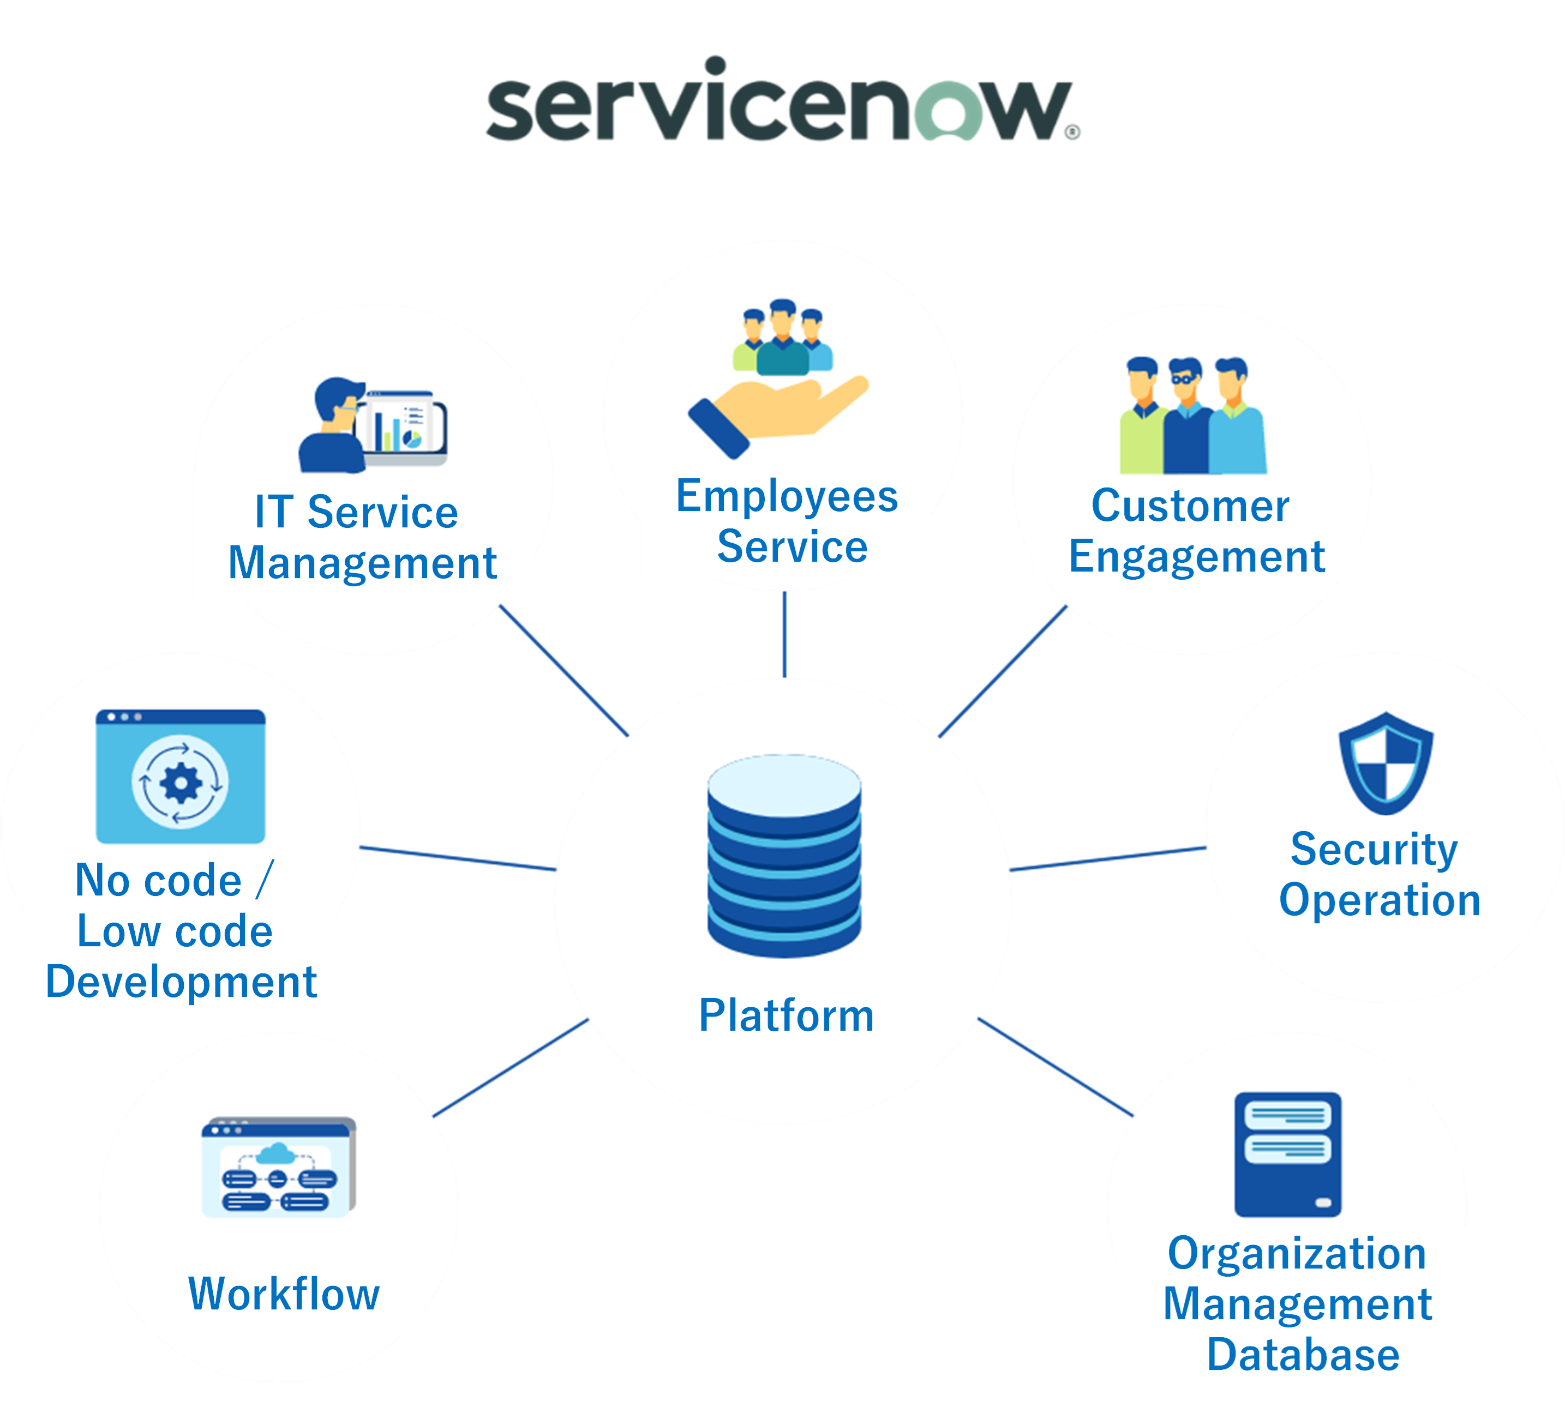

DAY 02

Slide 5
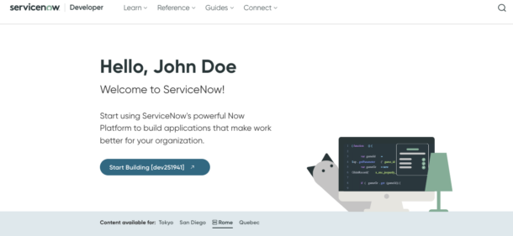
DAY 02
CREATE ACCOUNT

Slide 6
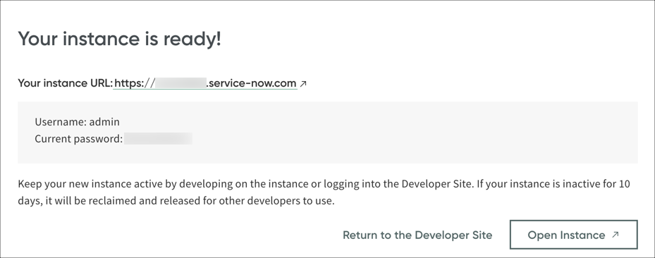
DAY 02
REQUEST INSTANCE

Slide 7
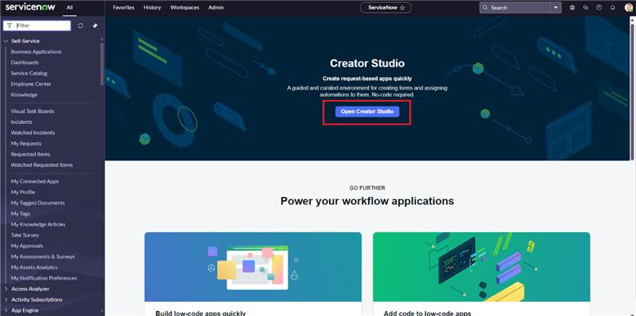
DAY 02
START BUILDING

Slide 8
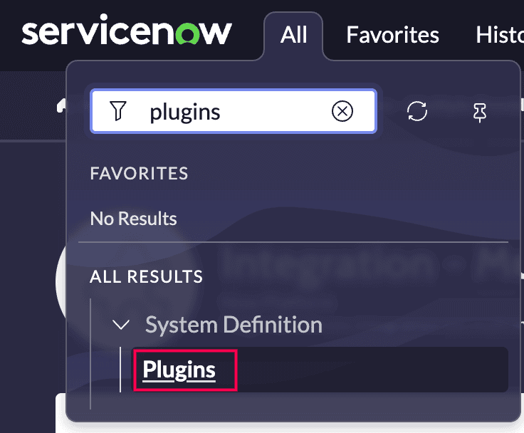
DAY 02
DOWNLOAD PLUGINS

Slide 9
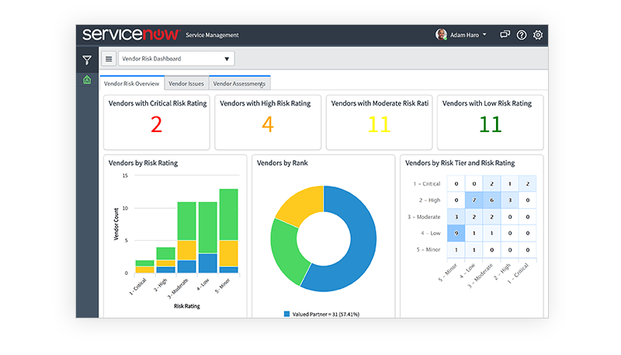
DAY 02
UNDERSTAND USE OF WORKSPACE

Slide 10
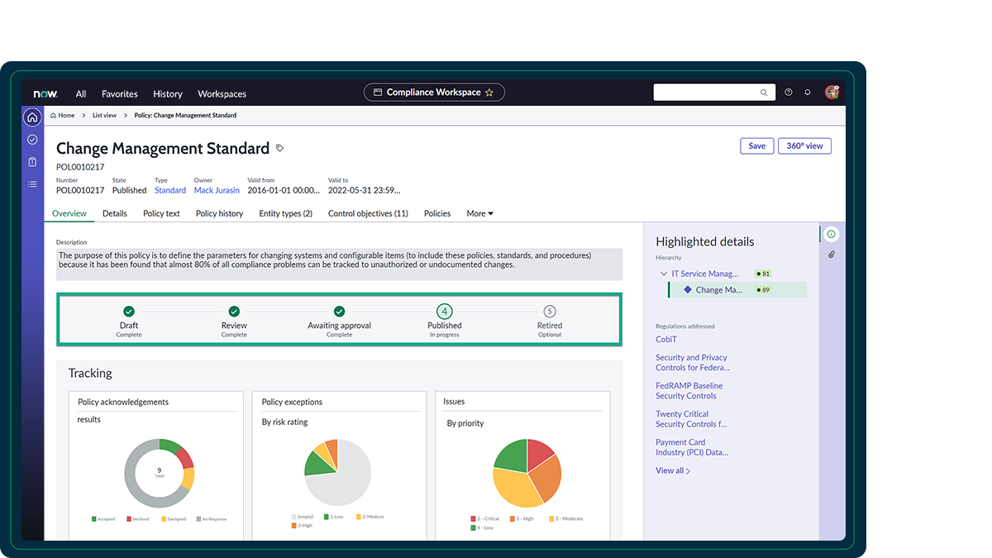
DAY 02
CREATE LIFECYCLE

Slide 11
DAY 02
ANY QUESTIONS?

Slide 12

WHAT’S COMING NEXT?
VULNERABILITY ASSESSMENTS AND PENETRATION TESTING
CONCEPT
USES
BENEFITS
LIMITATIONS

Slide 13
THANK YOU

