Slide 1

What We Covered Yesterday
INTEGRATED GRC
&
SERVICENOW TOOL INTRO

Slide 2

Today’s AGENDA
DAY 03
VULNERABILITY ASSESSMENTS AND PENETRATION TESTING
CONCEPT
USES
BENEFITS
LIMITATIONS

Slide 3

VULNEABILITY SCANS (ASSESSMENTS)
DAY 03

Slide 4
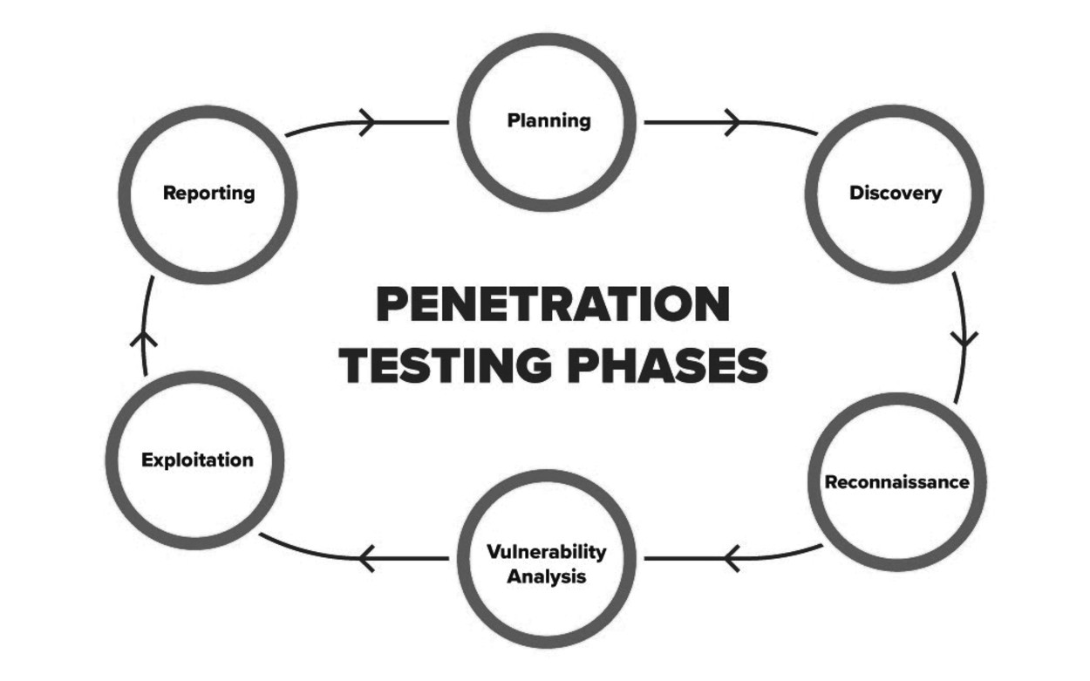
PENETRATION TESTING
DAY 03

Slide 5

DAY 03

Slide 6

DAY 03
LIMITATONS

Slide 7
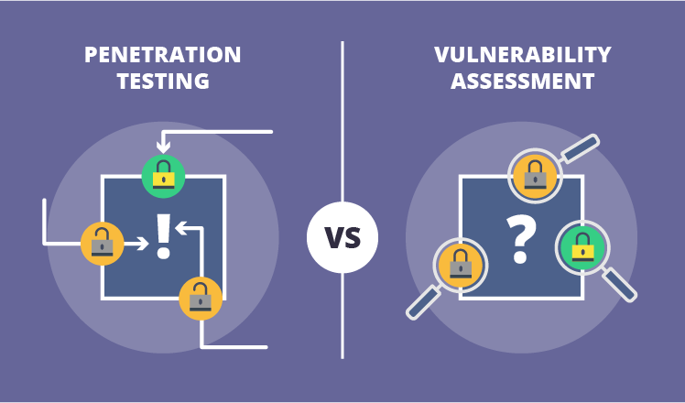
DAY 03

Slide 8

DAY 03
TOOL RECOMMENDATION

Slide 9

DAY 03
KALI LINUX

Slide 10

DAY 03

Slide 11
WHAT’S COMING NEXT?
Kali Linux for Cybersecurity Testing
• Introduction to Kali Linux
• Common Tools in Kali (Nmap, Metasploit, etc.)
• Live Demonstration and Practice

Slide 12
Thank You

