Slide 1

VULNERABILITY ASSESSMENTS AND PENETRATION TESTING
CONCEPT
USES
BENEFITS
LIMITATIONS
WHAT WE COVERED YESTERDAY

Slide 2
KALI LINUX FOR VULNERABILITY SCAN AND
PEN TESTING
DAY 04
TODAY’S AGENDA

Slide 3
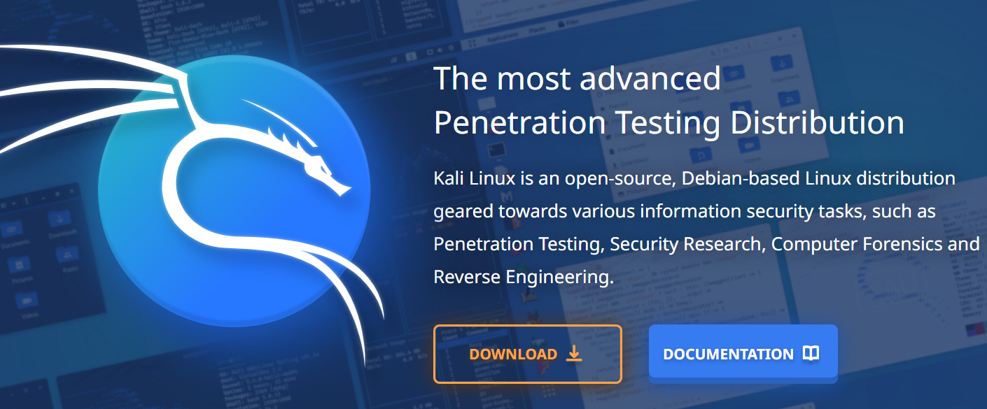
DAY 04
ON BROWSER- TYPE KALI LINUX AND CLICK ON DOWNLOAD

Slide 4
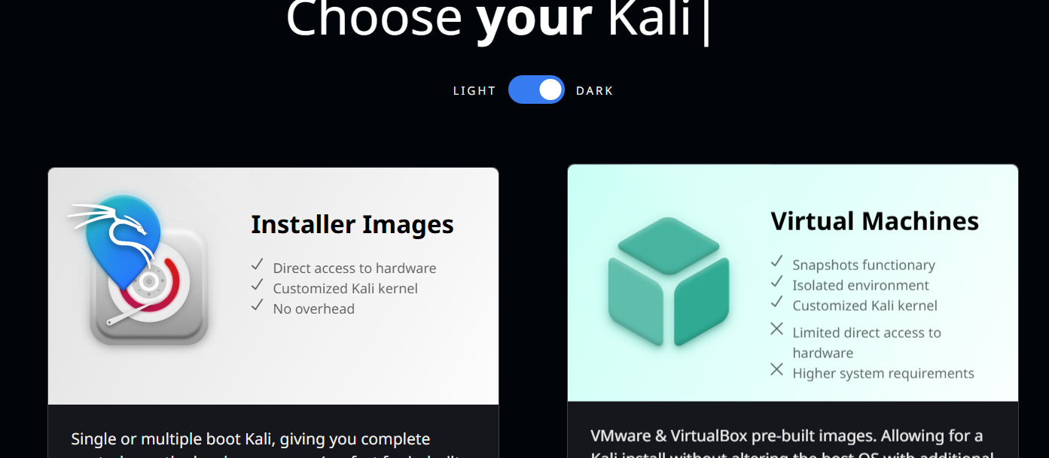
DAY 04
Choose VM

Slide 5
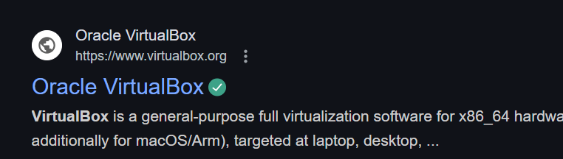
DAY 04
On the browser- type virtualbox and click on first link

Slide 6
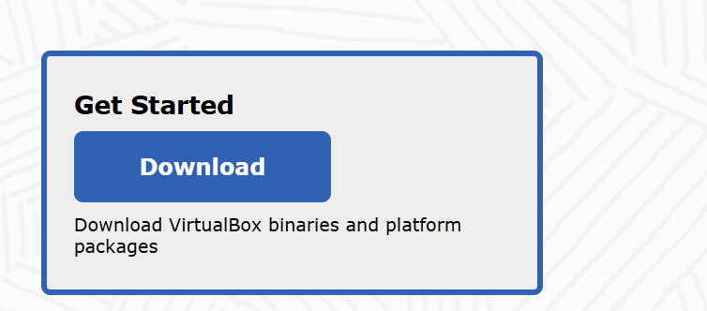
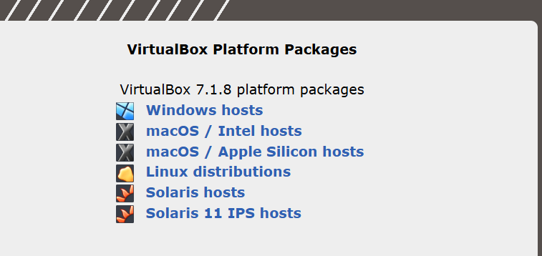
DAY 04
Click on download- select windows/ mac and let it download

Slide 7
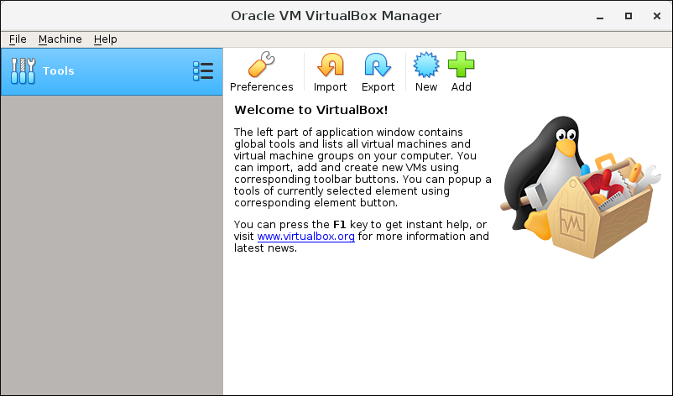
DAY 04
Open Oracle VM manager app and click on add

Slide 8
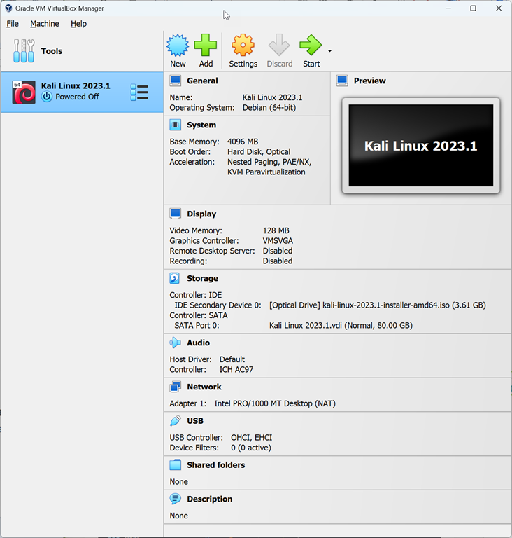
DAY 04
Click on Start and it should launch Kali VM

Slide 9
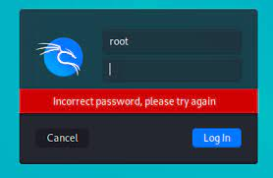
DAY 04
It should ask login credentials: by default it is kali for both username and password

Slide 10
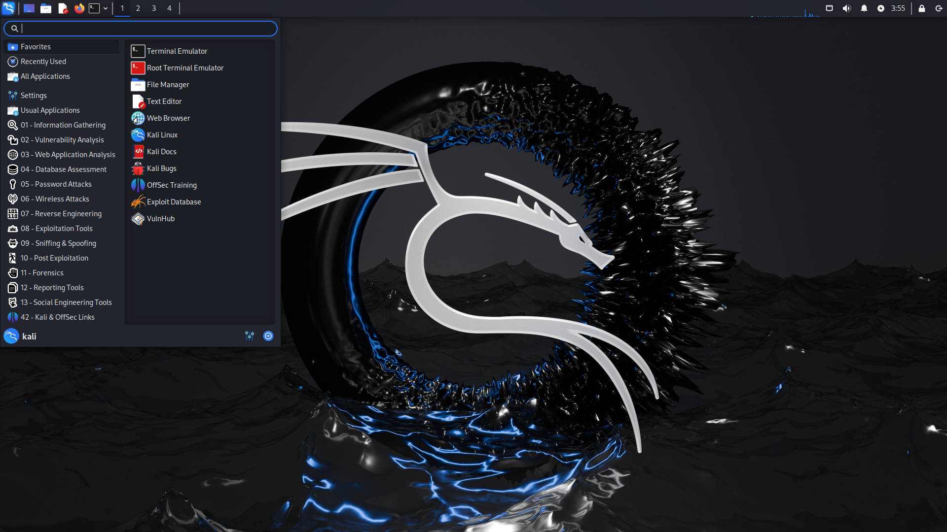
DAY 04
Once Credentials are entered correctly Kali home page show up and KALI is successfully installed

Slide 11

DAY 04

Slide 12
DAY 04
WHAT’S COMING NEXT?
Introduction to IT Audits + Q&A
• What is an IT Audit? (Brief Overview)
• Purpose and Scope of IT Audits
• Final Q&A: Get Your Questions Answered

Slide 13
THANK YOU

